Slide 1
PIPSICO SUMMER RESIDENT CAMP 2024
Leaders Zoom Meeting – May 29, 2024

Slide 2
Staff Introductions
GREAT SENIOR TEAM

Slide 3
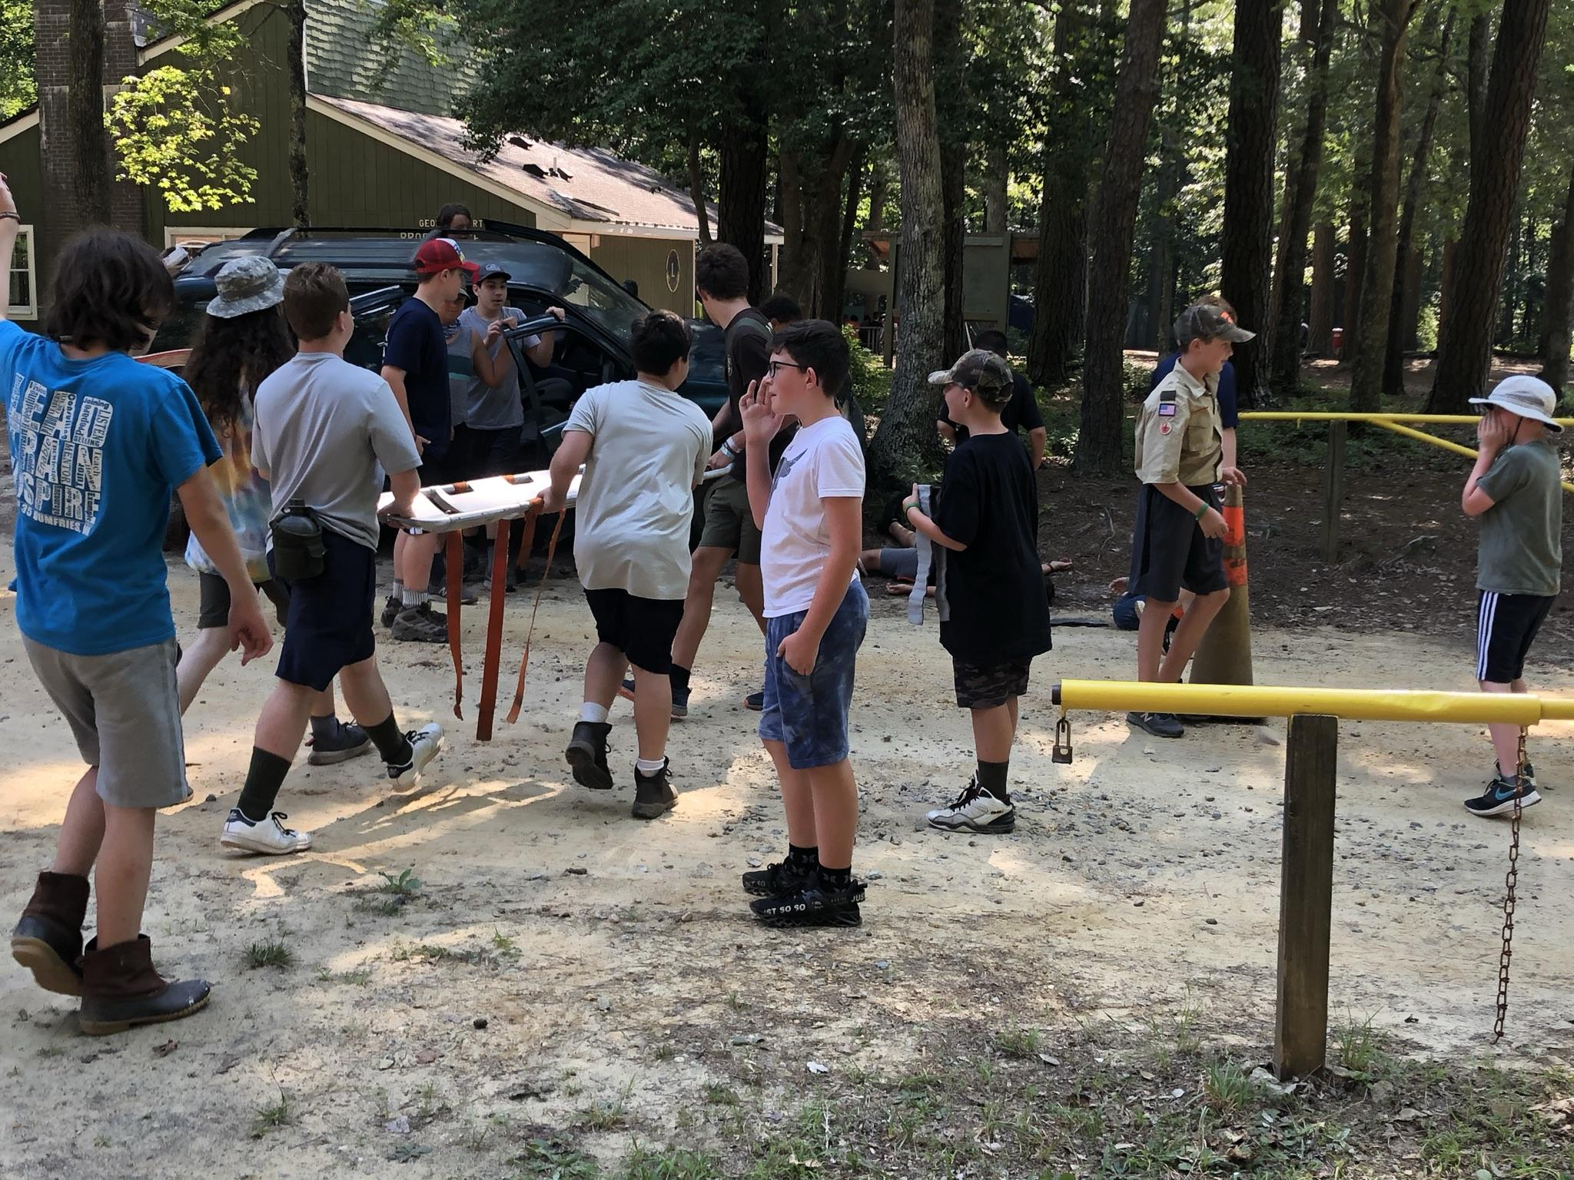
Health and Safety Update
Traveling to Camp

Slide 4
Travel to Camp
Motor vehicle accidents can lead to serious injuries and even fatalities—not only for the driver but for passengers and others on the road. The excitement of traveling to camp, coupled with the noise and enthusiasm of Scouts we are transporting can lead to distracted driving. In addition, departing camp after a successful but long and tiring week can also lead to drowsy driving.
Review the Guide to Safe Scouting section on Transportation. Remember driving time is limited to a maximum of 10 hours in one 24-hour period, regardless of number of drivers available.
Participate in the “Risk Zone: Transporting Scouts Safely” training as part of their pre-camp preparation.
Review Scouting’s Safety Moments on this important topic – including during the camp session(s).
Encourage leaders to participate in “Nap on Safely” during your camp session(s).
Schedule camp departures appropriately. Leaving late, at the end of a long camp day, can lead to motor vehicle accidents.
Limit distractions – especially use of mobile phones.
Stop driving if they feel tired.

Slide 5
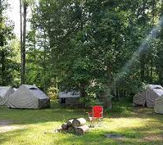
Summer Camp— The Great Experiment in Communal Living
Camp is to supplement unit programming
Give the benefit of the doubt
Work together
Pitch in
Give grace
Assume good intentions

Slide 6
Scouters Code of Conduct
Applies to all Scouters at Camp
Available at https://www.scouting.org/health-and-safety/gss/bsa-scouter-code-of-conduct/
A few highlights:
I will not discuss or engage in any form of sexual conduct while engaged in Scouting activities. I will refer Scouts with questions regarding these topics to talk to their parents or spiritual advisor.
I will not possess, distribute, transport, consume, or use any of the following items prohibited by law or in violation of any Scouting rules, regulations, and policies:
Alcoholic beverages or controlled substances, including marijuana
Concealed or unconcealed firearms, fireworks, or explosives
Pornography or materials containing words or images inconsistent with Scouting values
If I am taking prescription medications with the potential of impairing my functioning or judgment, I will not engage in activities that would put Scouts at risk, including driving or operating equipment.

Slide 7
Tenting at Pipsico
Tent calculations assume 2 people per tent. Feel free to bring troop tents as well.
Campsites are managed by the unit, which is expected to comply with Scouting rules, including:
Age ranges – no more than 2 years apart for youth
Male youth tent with male youth; female youth tent with female youth; transgender tentmate’s parents must give permission in writing.
Male adults with male adults; female adults with female adults; married couples okay
Refresh at https://www.scouting.org/health-and-safety/gss/gss01/#:~:text=In%20Cub%20Scouting%2C%20parents%20and,Spouses%20may%20share%20tents.
Guide to Safe Scouting rules apply to hammock camping.

Slide 8
Checking In
Pre-camp packets were mailed over the last two weeks to BlackPug POC
Please read the materials in the packet
Buddy tags – 2 per Scout (if received white and black ringed, then one of each per Scout)
Specialty meals requests should have all been submitted by June 1.
We assign check-in times. They will come out in about a week.
Only the SM and the SPL need to come to the Burton Center. The rest of the troop should wait out of the way.
SM should bring medical forms to Burton Center.
Scouts should arrive in swimsuits with towels – unless the troop has pre-swim checked.

Slide 9
Campsite Assignments, Vehicles, and Trailers
Campsite assignments will be provided at check-in
All units/people must check-in through Burton Center
Campsites are assigned based on final numbers, which unfortunately remain in flux, as well as medical necessary and requests.
Vehicle permitted only with pass and only during check-in/check-out; 1 pass per unit.
Trailer may be left at campsite for duration of week.

Slide 10
Program Update
Welcome offers from adult leaders to assist as MB counselors where we need help. Contact us at summercamp@pipsicobsa.com with subject line: “MB Counselor offer – Week ##”

Slide 11
Pre-swim check
Strongly encouraged
$20 to get a YMCA lane at Hampton Roads YMCA.
If doing swim check at camp, arrive in bathing suits.

Slide 12
2024 Webelos and Cub Camps
Theme: Bug Hunters
Program Changes:
Webelos arrive in Thursday; Webelos specific activities until Cubs arrive
Cubs arrive on Friday
all meals in Dining Hall and Included

Slide 13
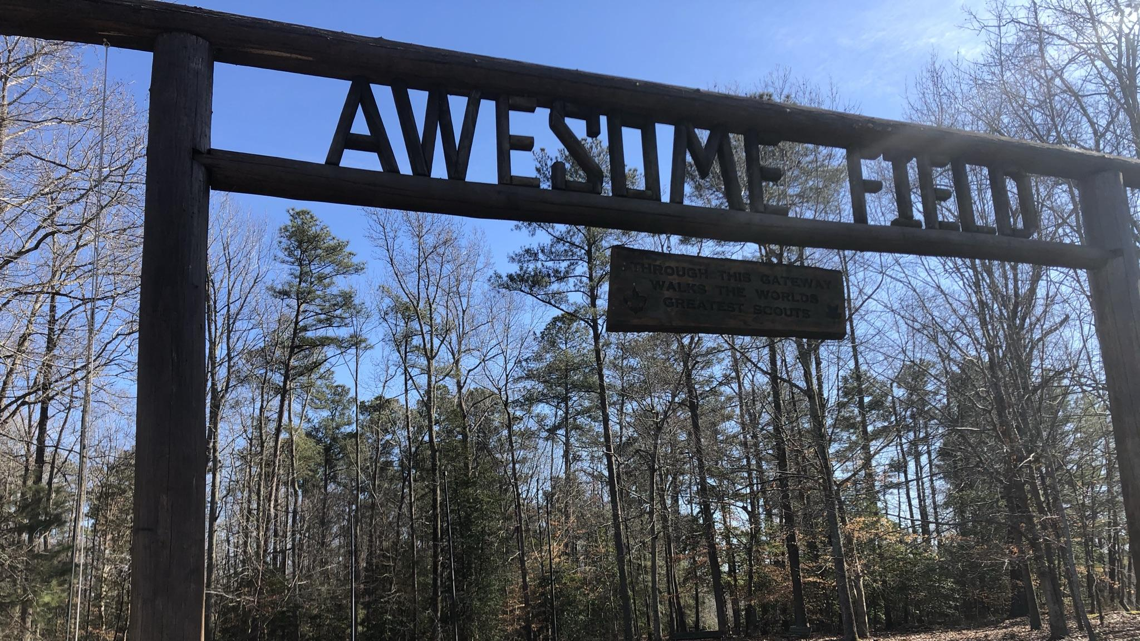
Key Resources
Leaders Guide -- https://pipsicobsa.com/wp-content/uploads/2023/10/24_-SBSA-Leaders-Guide.pdf
Merit Badge Info --https://pipsicobsa.com/wp-content/uploads/2023/11/24_-SBSA-MB-Guide.pdf

