Slide 1

PIPSICO SUMMER RESIDENT CAMP 2023
Leaders Zoom Meeting – April 6, 2023

Slide 2

Staff Introductions

Slide 3
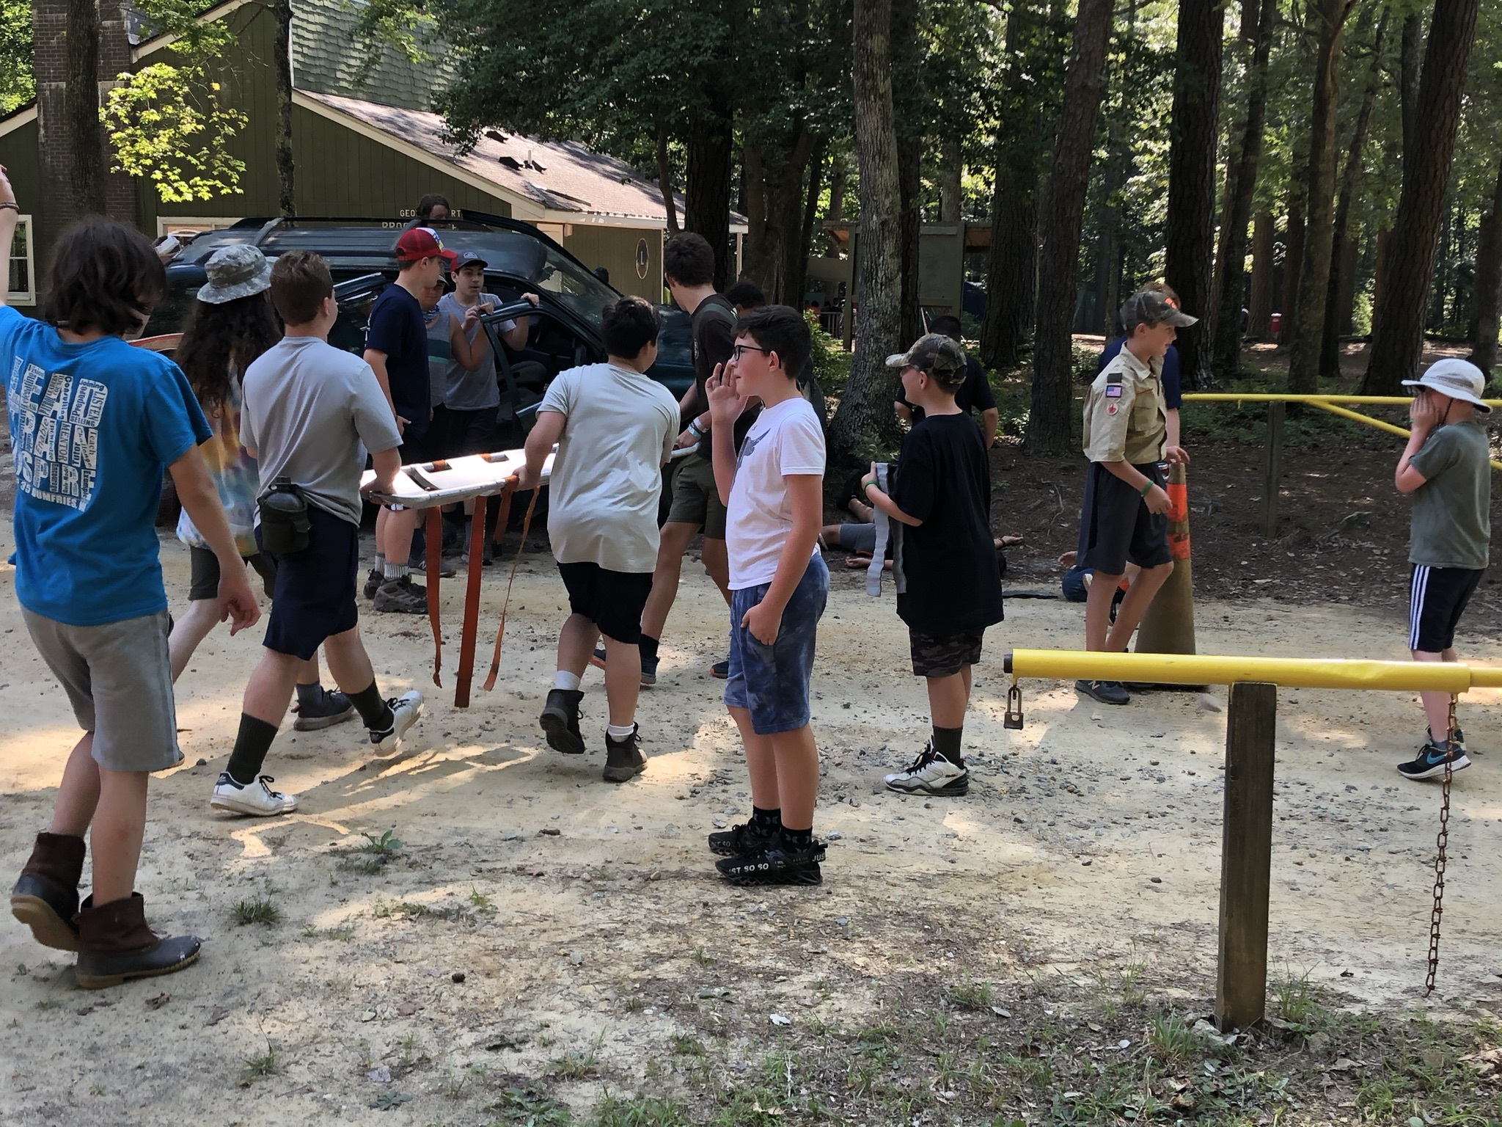
Health and Safety Update

Slide 4

Merit Badge Program Update
More than 1600 MBs registered for in first 20 minutes
Scouts on Waitlist for Week 1 and Week 3 should assume that they will not get that MB
Week 1 and 3 request for MB counselors to open new sessions and badges. Contact summercamp@pipsicobsa.com with subject line “Offer to Serve As MB Counselor”

Slide 5
Checking In
We send a pre-camp packet in late May with key information and buddy tags – PLEASE READ
We assign check-in times. If your unit has a specific requested time please send to summercamp@pipsicobsa.com with the subject line “Check-In Time Request – Week #__”
Only the SM and the Senior Patrol need to come to the Burton Center. The rest of the troop should wait out of the way.
SM should bring medical forms to Burton Center.
Scouts should arrive in swimsuits with towels – unless the troop has pre-swim checked.
WEEKS 1 and 3 are strongly encouraged to pre-swim check.

Slide 6
Checking Out
Breakfast on Dining Hall porch
Have troop out of the site and in the parking lot no later than 9:00am
Check-out at the Burton Center where you will receive medical forms, patches, etc.
Note: Our normal process is to NOT use blue cards. MB records can be accessed on BlackPug

Slide 7
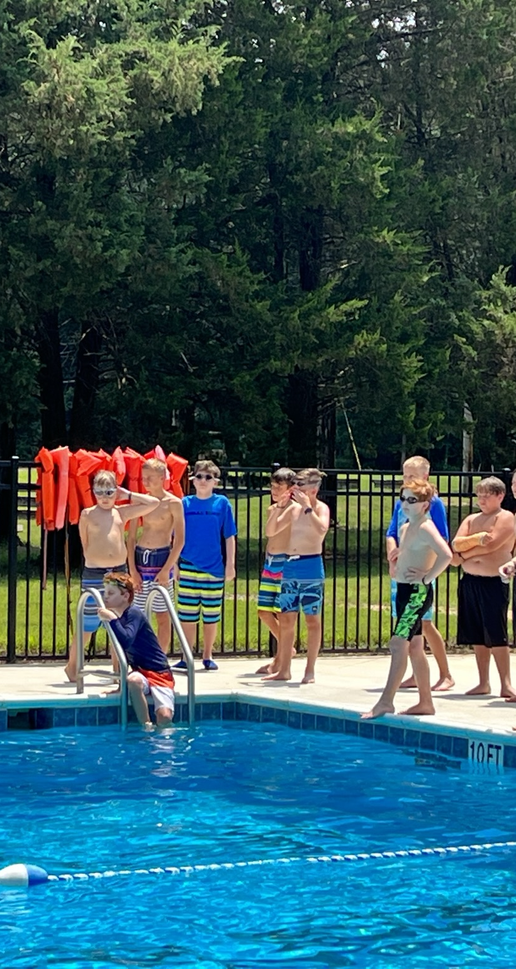
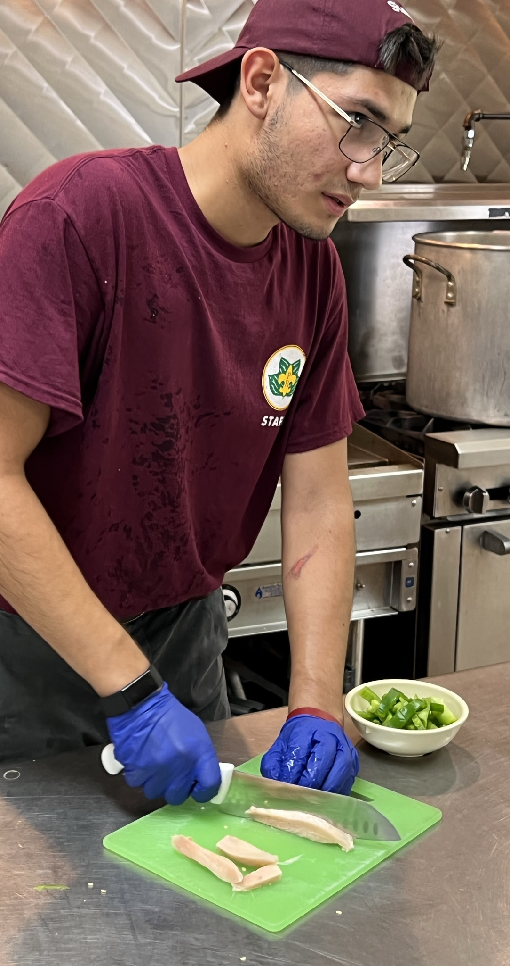
Looking Ahead
Specialty meal requests submitted on the form to – foodservice@pipsicobsa.com
Pre-swim checks – test is about proficiency in swim stroke (not whether the Scout can survive for 100 yards)
Medical Forms (not in individual sleeves)

Slide 8
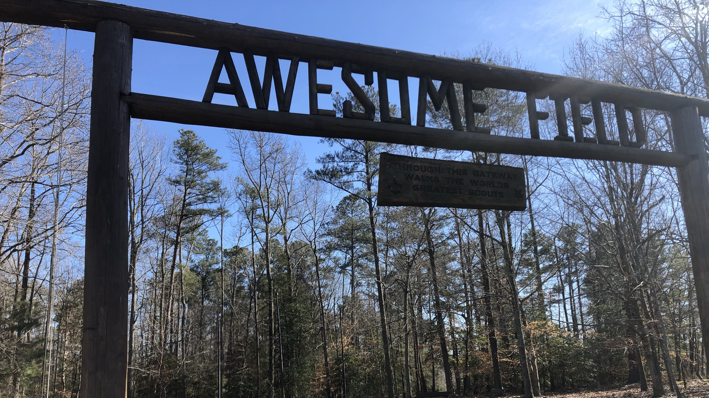
Key Resources
Leaders Guide -- https://pipsicobsa.com/wp-content/uploads/2022/10/23_-SBSA-Leaders-Guide.pdf
Merit Badge Info -- https://pipsicobsa.com/wp-content/uploads/2023/01/23_-SBSA-MB-Guide.pdf

